Slide 1








How can we promote financial inclusivity to underserved small enterprises within the Asia Pacific region?
Vedant Mehrotra
Year 4 Artificial Intelligence & Cyber Security Major
Amey Rathi
Year 4 Economics & Artificial Intelligence Major
Renata Dharma
Year 4 Smart Cities Management & Technology Major
Cindy
Year 4 Software Development & Financial Technology Major
Ojus Sharma
Year 4 Economics & Public Policy & Public Management Major
Team VAR CO. Presents:
Crowdly
Enabling Enterprises Through Crowdfunding
Notes:
Greetings I am Vedant from Team VARCO and welcome to our presentation on Crowdly: Enabling enterprises through crowdfunding

Slide 2









Executive Summary
Challenge statement
How can we promote financial inclusivity to underserved small enterprises within the Asia Pacific region?
Key issues identified
Inability for small businesses to raise capital
Lack of long-term support for small enterprises
Operational issues are a leading cause of early failure
Our solution
Crowdly
An all-in-one solution to help budding entrepreneurs secure funding and ensure long term operation
Uses crowdfunding to provide start-up capital to small, underserved enterprises
Leverages Goldman Sachs’ strong financial foundation to provide accreditation to small businesses
Provides a digital asset management tool that can be used to assist with operations
3-pronged approach
Key value proposition
Creating a fully fledged system to help raise start-up capital for small enterprises in the short run and providing long term support via digital tools and advisors
Impact
Increase funding among small businesses
Provides service oppotunity for Goldman Sachs
Transitions businesses into the digital age
2
Notes:
Our team sought to answer the question of how we could promote financial inclusivity to the underserved small enterprises in Asia Pacific.
Through our research, we discovered 3 key issues they face:
Inability to raise capital
Lack of long term support
Operational issues that lead to early failure
To solve these, we created Crowdly: an all in one solution to help budding entrepreneurs secure funding and ensure long term operation
Crowdly uses crowdfunding to provide startup capital, leverages Goldman Sach’s strong financial foundation to accredit small businesses and provides them a digital toolset to assist operations
Therefore it increases funding to small businesses, provides a CSR opportunity for Goldman Sachs and transitions businesses into the digital age.

Slide 3








Lack of financial inclusivity is a serious issue not only in APAC but across the world
Financial exclusivity is a huge issue in APAC and across the globe. It causes businesses to fail within their first few years of operation and prevents them from having long term success.
Small businesses fail due to a lack of funding
Operational issues are a key reason for failure
Global impact of financial exclusivity
70% of small businesses and start-ups fail within 10 years due to lack of funding and 20% fail within just the first year.
Most businesses fail fast
82% of businesses that fail claim it was due to poor cash flow and operational management.
Lack of long term support to manage operations
APAC enterprises are in dire need of inclusivity
Crowdfunding market is rising, especially in APAC
Regional impact of financial exclusivity
Financial inclusivity is starkly absent in APAC as 67% of all enterprises don’t possess any direct line of credit from a financial institution
The market for crowdfunding platforms is expected to hit US$ 196.36bn by 2025 with a 62% of growth being attributed to APAC
Majority businesses not having financial support
Alternate solutions like crowdfunding on the rise
This is where Crowdly comes in: By implementing cutting edge technology, we aim to provide funding and long term operational support to underserved small enterprises in the Asia-Pacific region.
Sources: Technavio,Asian Development Bank, Fundera, Investopedia
3
Notes:
Financial exclusivity is a huge issue in APAC and across the globe. It causes businesses to fail within their first few years of operation and prevents them from having long term success.
The global impact of this financial exclusivity can be seen by how most businesses fail quickly and the large part that cash flow and operational management play in it.
The issue is evidenced more clearly in the scope of the APAC region where majority of enterprises lack any concrete means of institutional financing thus having to resort to alternate means like crowdfunding.
This is where Crowdly comes in to leverage the booming crowdfunding market. By implementing cutting edge technology, we aim to provide funding and long term operational support to underserved small enterprises in the Asia-Pacific region.

Slide 4



Crowdly targets 3 key issues for small businesses and startups
The problem of start-up failure can be broken down into 3 key issues:
Inability for small businesses to raise capital
Lack of long-term support for small enterprises
Operational issues are a leading cause of early failure
There is no easy way for small businesses to secure funding through a secure line of credit as many budding entrepreneurs lack much collateral for loans and grants are few and far between.
Many small businesses run out of capital in the first 10 years and are unable to raise any further funds. This can be a huge issue since they wouldn’t have any records to easily show their credibility when requesting funding.
Data management in the digital age has become extremely easy but effective solutions are costly. Small, underserved enterprises are unable to utilize such operational tools.
By allowing small businesses to request for capital via crowdfunding, we make the process of seed funding more accessible
Our solution is vetted by leading accreditor, Goldman Sachs’ employees to ensure businesses that apply receive the needed advice to be long lasting.
Crowdly doesn’t just stop at providing crowdfunding solutions but also assists enterprises by providing effective data management solutions for operational needs.
Crowdly aims to provide a platform that not only provides start-up capital for enterprises in the short run but also long term support for them to keep growing without facing any operational issues.
4
Notes:
The failure of small businesses can be broken into 3 key issues:
Firstly is the inability of small businesses to raise capital as they do not have a secure line of credit or lack much collateral to secure loans. Crowdly allows them to request capital via crowdfunding, making seed funding more accessible
Secondly, there is a lack of end to end long term support to keep these businesses afloat which is why so many don’t make it past ten years. They also lack credibility and defined records and statements to secure funding in these later stages. Crowdly leverages Goldman Sachs’ top class employees to ensure businesses get the support they need whilst opening a portal for volunteerism within GS.
Lastly, operational issues are a leading cause of early failure. Many startups in economically developed countries are going digital with their operational tools but those in underserved communities remain analog and are unable to utilize such tools. Crowdly doesn’t stop at short term funding but also assists enterprises with effective data management solutions for operational needs.
There fore, crowdly aims to provide a platform that not only provides start-up capital for enterprises in the short run but also long term support for them to keep growing without facing any operational issues.

Slide 5
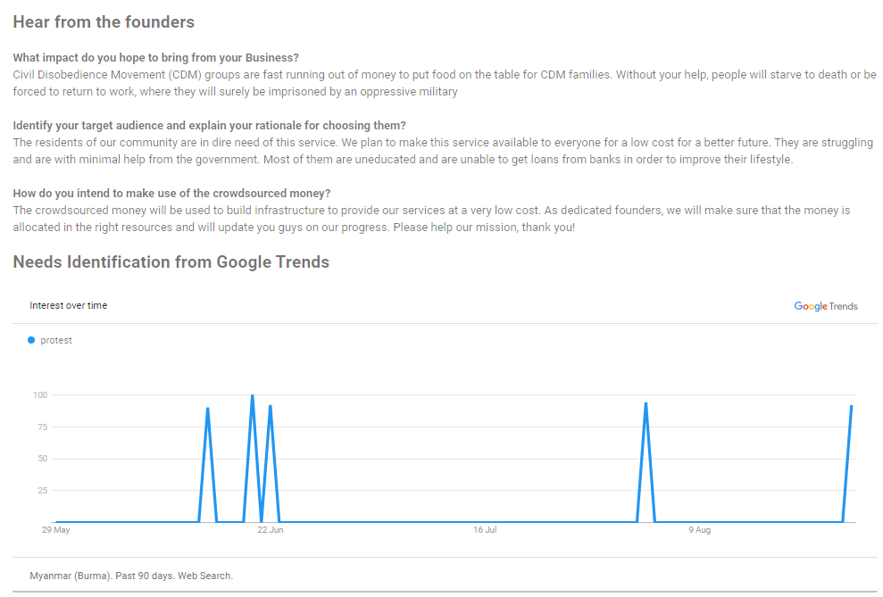
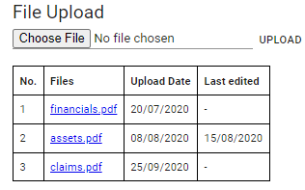
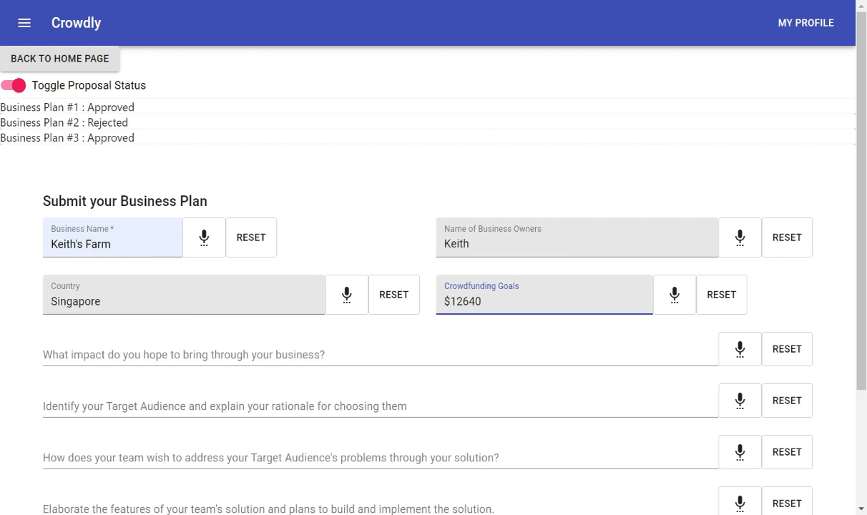
SSR uses a suite of cutting-edge technology for best results
The following technology verticals have been leveraged for the solution:
Google Trend Analytics
Speech Recognition & Translation
Cloud Data Platform
Searching keywords in the business categories to determine overall popularity and potential of proposed business
Continuous flow of data to point users to the latest trends
Easy to interpret by anyone
Overcomes any language barriers for anyone with brilliant business ideas
Allows applicants to either type or speak into the form, thereby saving time and opening opportunities to all
Executed via AWS translate and AWS transcribe with accurate results
Digital asset management for business owners to have all their documents stored in one place
Provides convenience of document access and storage
Scalable due to AWS S3 large cloud storage
5

Slide 6
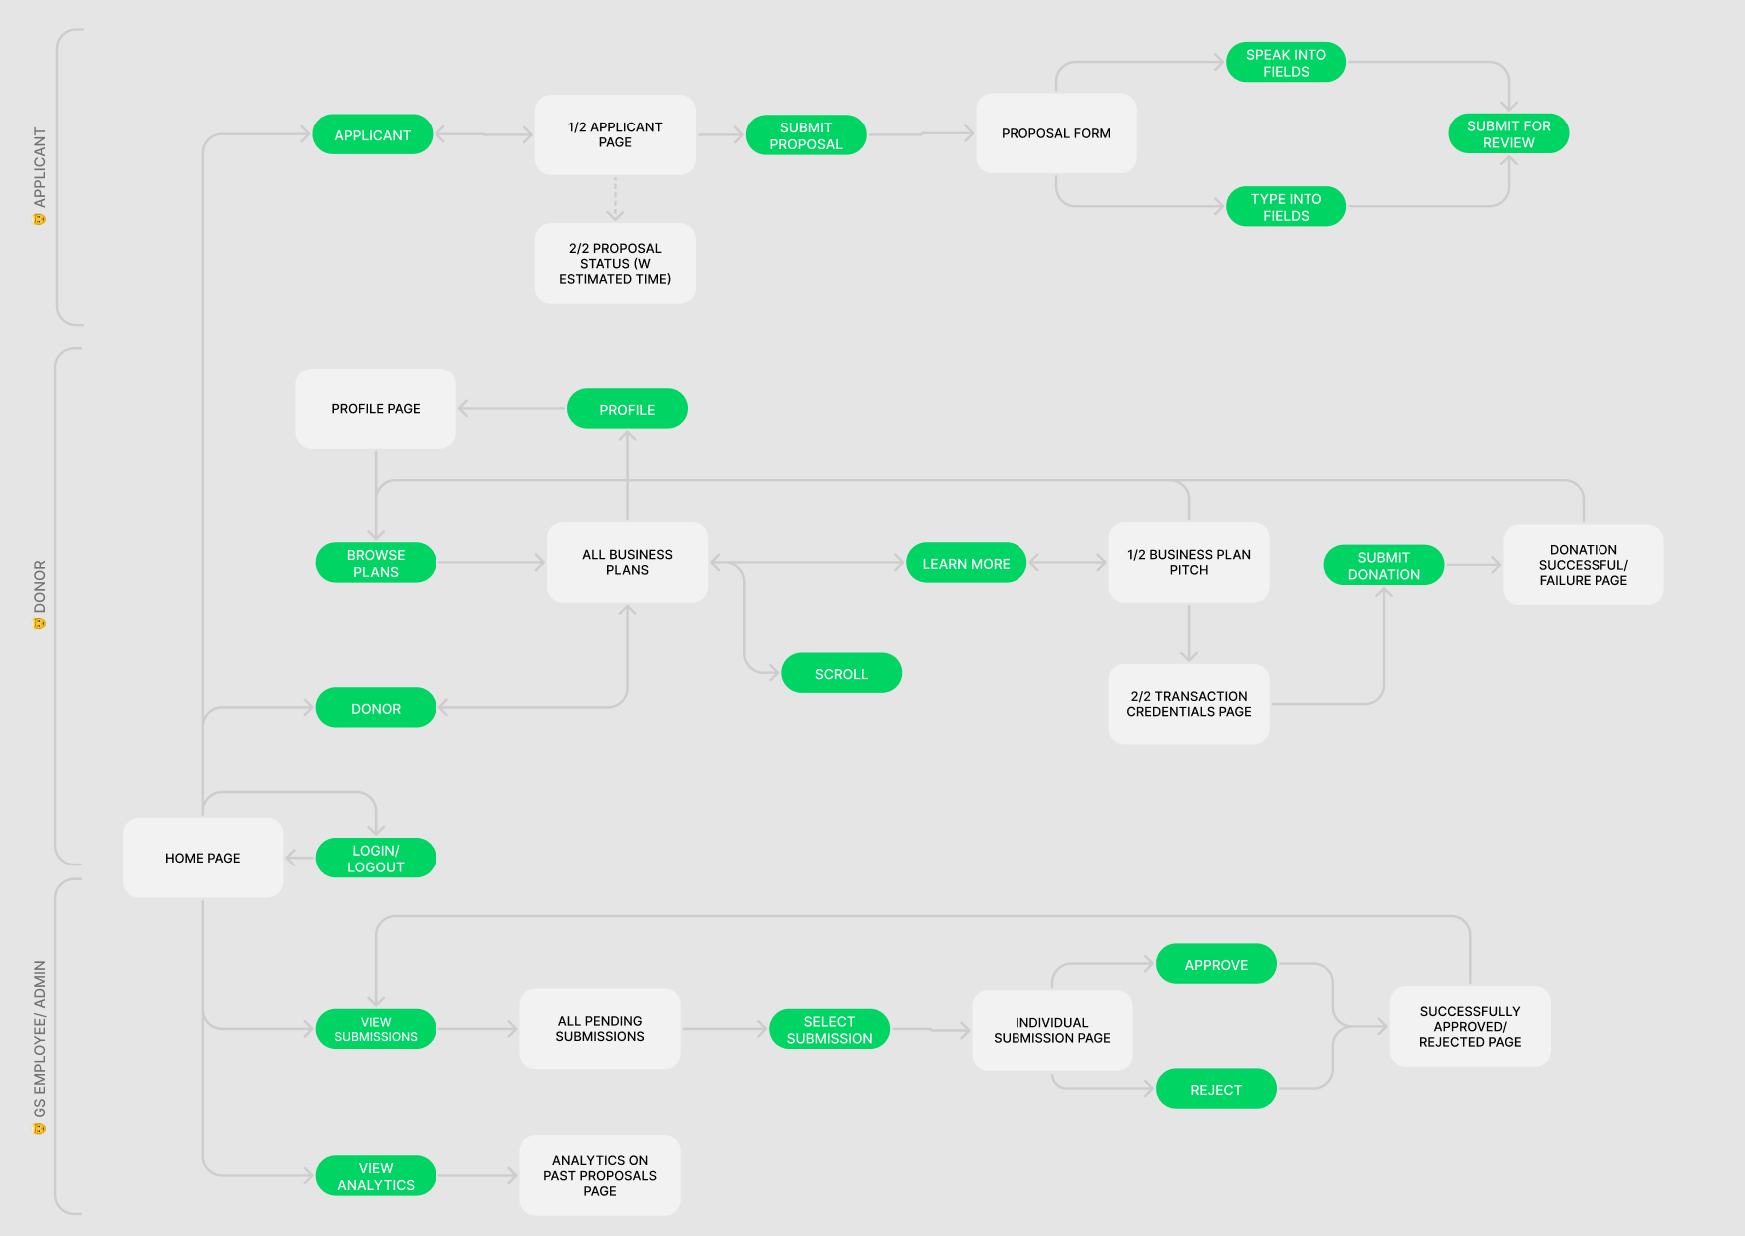
Crowdly ensures smooth user experience multi laterally
Three main users: applicants, donors, GS employees
Applicants: main aim is to apply without worrying about finances, main emphasis on business valuation
Donor: main aim is to donate with ease and observe transparency from each applicant's pitch
GS employee: main aim is to approve and reject proposals
Designed with minimal screen transitions to achieve less than 6 touchpoints to reach their main goals

Slide 7




Crowdly provides an all-in-one solution to fund and optimize small enterprises
Technical capabilities
Value propositions
 |  |  |  | Digital Asset Management | Crowdfunding | Offer long term support
Capabilities
Google Trends analytics
Speech Recognition
Cloud Based
Existing solutions
Kiva
A microloan based crowdfunding platform
Kickstarter
One of the biggest crowdfunding platforms in the world
ProofHub
Business management software that helps with operations and asset management
Crowdly
Sources: Proofhub, Kickstarter, Kiva
7
Notes:
Crowdly also surpasses all competitors in its field by providing more technical capabilities and better value propositions.

Slide 8





Crowdly promises multi-lateral impacts that are feasible
Feasibility
 | This solution is targeted at small businesses that cannot raise capital within the APAC region. It will also improve employment as small businesses account for employment of 50% of the workforce | Due to the huge proportion of underserved businesses, many will adopt alternative lines to capital. This can be evidenced by the success of mobile crowdfunding platforms in Africa like M-Changa
 | Transitioning analogue business processes into the digital era and optimizing operational procedures | AWS Services and the latest technologies available are capable of delivering what we set out to achieve
 | SME’s make up 98% of all enterprises, so such a solution is guaranteed to improve growth, especially in higher income countries where they contribute upto 50% of the national GDP | The main cost for utilizing this solution will be the initial time cost of Goldman Sachs employees who will need to devote attention to vetting and advising businesses as part of volunteerism efforts.
Level
Impact
Category
Social
Technical
Financial
Crowdly aims to have social, technical and financial impacts whilst remaining fully feasible to implement in the target region.
8
Notes:
Crowdly targets small businesses which make up a huge portion of enterprises in APAC, leading to not only social benefits via an increase in employment but also improving the GDP contributions of this sector of the economy. Furthermore, transitioning analog business processes in these underserved sectors will enable a transition to the digital era.
Crowdly is an impactful product, but what about feasibility? Well, due to the huge proportion of aforementioned underserved small enterprises, crowdfunding is quick on the uptake. This is not only evidenced by the booming crowdfunding market in APAC but also the success of platforms in other developing countries like M-Changa in Africa. This solution will also be a low cost one to Goldman Sachs as it will only require the time cost of employees but in turn offer them an opportunity to address the needs of entrepreneurs in need. (add technical feasibility)

Slide 9
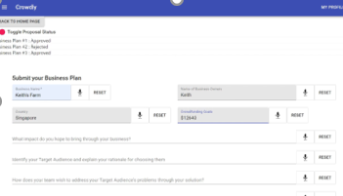

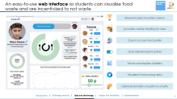
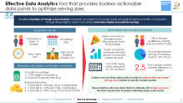
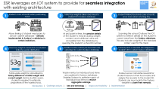
In conclusion
The main question…
Was solved through 3 recommendations…
The resulting impact of Crowdly is…
Google Trend Analytics based Crowdfunding
Continuous flow of data to point users to the latest trends
Increase funding among small businesses
Objective
How can we promote financial inclusivity to underserved small enterprises within the Asia Pacific region?
Speech Recognition and Translation
Overcomes any language barriers for anyone with brilliant business ideas
Provides service opportunity for Goldman Sachs
Cloud Storage for Digital Asset Management
Transitions businesses into the digital age
Provides convenience of document access and storage
Notes:
In Conclusion, we aimed to solve the problem of promoting financial inclusivity to the underserved small enterprises in APAC and we achieved it with a solution that leverages technologies of data analytics, speech recognition and translation and cloud architecture that supports digital asset management. All this results in increasing funding among small businesses, providing volunteering opportunities for Goldman Sachs employees and transitioning small businesses into the digital age.

Slide 10
References
https://www.smefinanceforum.org/post/the-role-of-smes-in-asias-economic-growth
https://www.kiva.org/about/how
https://www.kickstarter.com/
https://www.changa.co.ke/
https://www.orange-business.com/en/blogs/connecting-technology/emerging-markets/microfinance-combines-with-crowdfunding-to-tackle-poverty\
https://www.fundera.com/blog/what-percentage-of-small-businesses-fail
https://www.prnewswire.com/news-releases/crowdfunding-market-to-grow-by-usd-196-36-billion-during-2021-2025--13-86-year-over-year-growth-in-2021--technavio-301249041.html
https://www.adb.org/publications/financial-inclusion-asia-overview
https://www.investopedia.com/articles/personal-finance/120815/4-most-common-reasons-small-business-fails.asp#:~:text=The%20most%20common%20reasons%20small,model%2C%20and%20unsuccessful%20marketing%20initiatives.

Slide 11


Easy, fast implementation
Activity
Progress
1st Phase
2nd Phase
3rd Phase
Sep
Oct
Nov
Dec
Jan
Feb
Mar
2
3
Internet of Things
The prototypes have already been developed for all the technical components. The main focus will be on integration of these components henceforth
Weighing scales
20%
P
Card scanners
20%
P
Data Analytics
Creation of Python backend
10%
P
P
Database web integration
20%
As seen, the entire integrated solution can be rolled out be January 2021, and awareness campaigns in schools can start from Dec 2020
Web development
Creation of webpage
20%
P
Commercial
0%
Onboarding of schools
0%
Awareness campaigns
0%
Today
P
Procurement of material
Technical Integration
Testing and limited release
Full rollout
Prototype developed
11

